Slide 1
6U-8U Division Meeting
August 25, 2025

Slide 2
THANK YOU!
Thank you for volunteering to coach! Because of you, our kids get to play soccer.

Slide 3
Agenda
Your Admins
Coach expectations, requirements & to do list
Parent & medical release forms
Uniforms and equipment
Supporting Coaches
What happens before, during and after games
When Coach/Referee problems arise & managing parents / spectators
Upcoming events
Miscellaneous items
Questions?

Slide 4
Your Admins
Divisional Admins |  | League Admins
B6U DCA | Lauren Stevenson & Mary Cholko | Regional Commissioner | Patrick Shopbell
G6U DCA | Jonathan Lui | Regional Coach Administrator | Brandi Lane
B7U DCA | Susan Streets | Deputy RCA | Susan Streets
G7U DCA | Brandi Lane | Regional Referee Admin | Harry Plotkin
B8U DCA | Tona Rodriguez
G8U DCA | Suset Chaney
6U-8U DRA | Harry Plotkin

Slide 5
What We Expect From Coaches
Conduct
PIE: Positive, Instructional, Encouraging
Coaches set the tone for players and parents
Be professional - we expect behavior that would
be acceptable at work
Referee Treatment
(Respect The Referee Policy)
Be nice to the refs
We’re all volunteers
Zero tolerance for referee criticism
Less than zero tolerance for yelling at or criticizing youth refs.
Manage your sideline. Coaches coach. Parents/spectators cheer. No one yells at refs.
Remember, we are a community. Coaches are a team with referees, parents, other coaches.
This year you might be on opposing teams, but next year you may be on the same team!
AYSO Vision & Philosophies
To provide world class youth soccer programs that enrich children’s lives
Development over winning
Positive Coaching

Slide 6
Coach Requirements
Volunteer Application & Background Check
Required annually, specifically for AYSO
AYSO uses Sterling Volunteers for background checks - do NOW (results can take weeks)
Livescan Fingerprinting (results can take weeks)
Training
(Helpful links: AYSO R13 Coach, Volunteer FAQ, AYSO 13 Calendar)
6U/8U Coach Course (online/in person + field session)
Safe Haven (online)
Safesport (online)
Sudden Cardiac Arrest (online)
CDC Concussion Course (online)
Why is this training required? → Volunteer Protection Act
Certification is Important!
If you do not complete your coaching requirements, you are not allowed to coach.
If your team does not have a certified coach present they cannot practice or play/participate in a game.

Slide 7

Coach To Do List
Practices Schedule
Coming soon!
Once received, check with your players for conflicts and let your DCA know
Confirm Your Players & Volunteers
If you have not received your roster, reach out to your DCA ASAP!
If you have not, reach out to all your players ASAP to introduce
yourself and confirm they are going to participate
Let your DCA know if any of your players are dropping / not playing
Confirm preassigned volunteers & recruit additional volunteers as needed - inform your DCA of new additions or change
Communications
Set your expectations for the parents - managing parents is more difficult than players
We recommend using a ‘team app’ e.g., Spond for communications. Check time zone!!
Your Team Manager could help with this!

Slide 8
Parent & Medical Release Forms
Parent Forms
Have parents sign CDC Concussion, Sudden Cardiac Arrest (SCA), and Parent Pledge
Forms available at https://ayso13.org/forms/
Upload pictures of signed CDC Concussion and SCA to https://ayso13.org/forms
Player Medical Release Forms
One coach (HC, AC, or sub coach) must have a physical copy of the medical release forms for each player at every game and practice (print them out, put them in a binder, keep it in your coach bag)
Recommended way of printing Medical Release Forms: https://ayso13.org/coach-training/medical-forms/
Forms are also on your Google Team Sheet. Sign into InLeague
before clicking on the form link in your Google Team Sheet, or
else you will receive an error.
Ask your Team Manager to help
with these tasks!

Slide 9
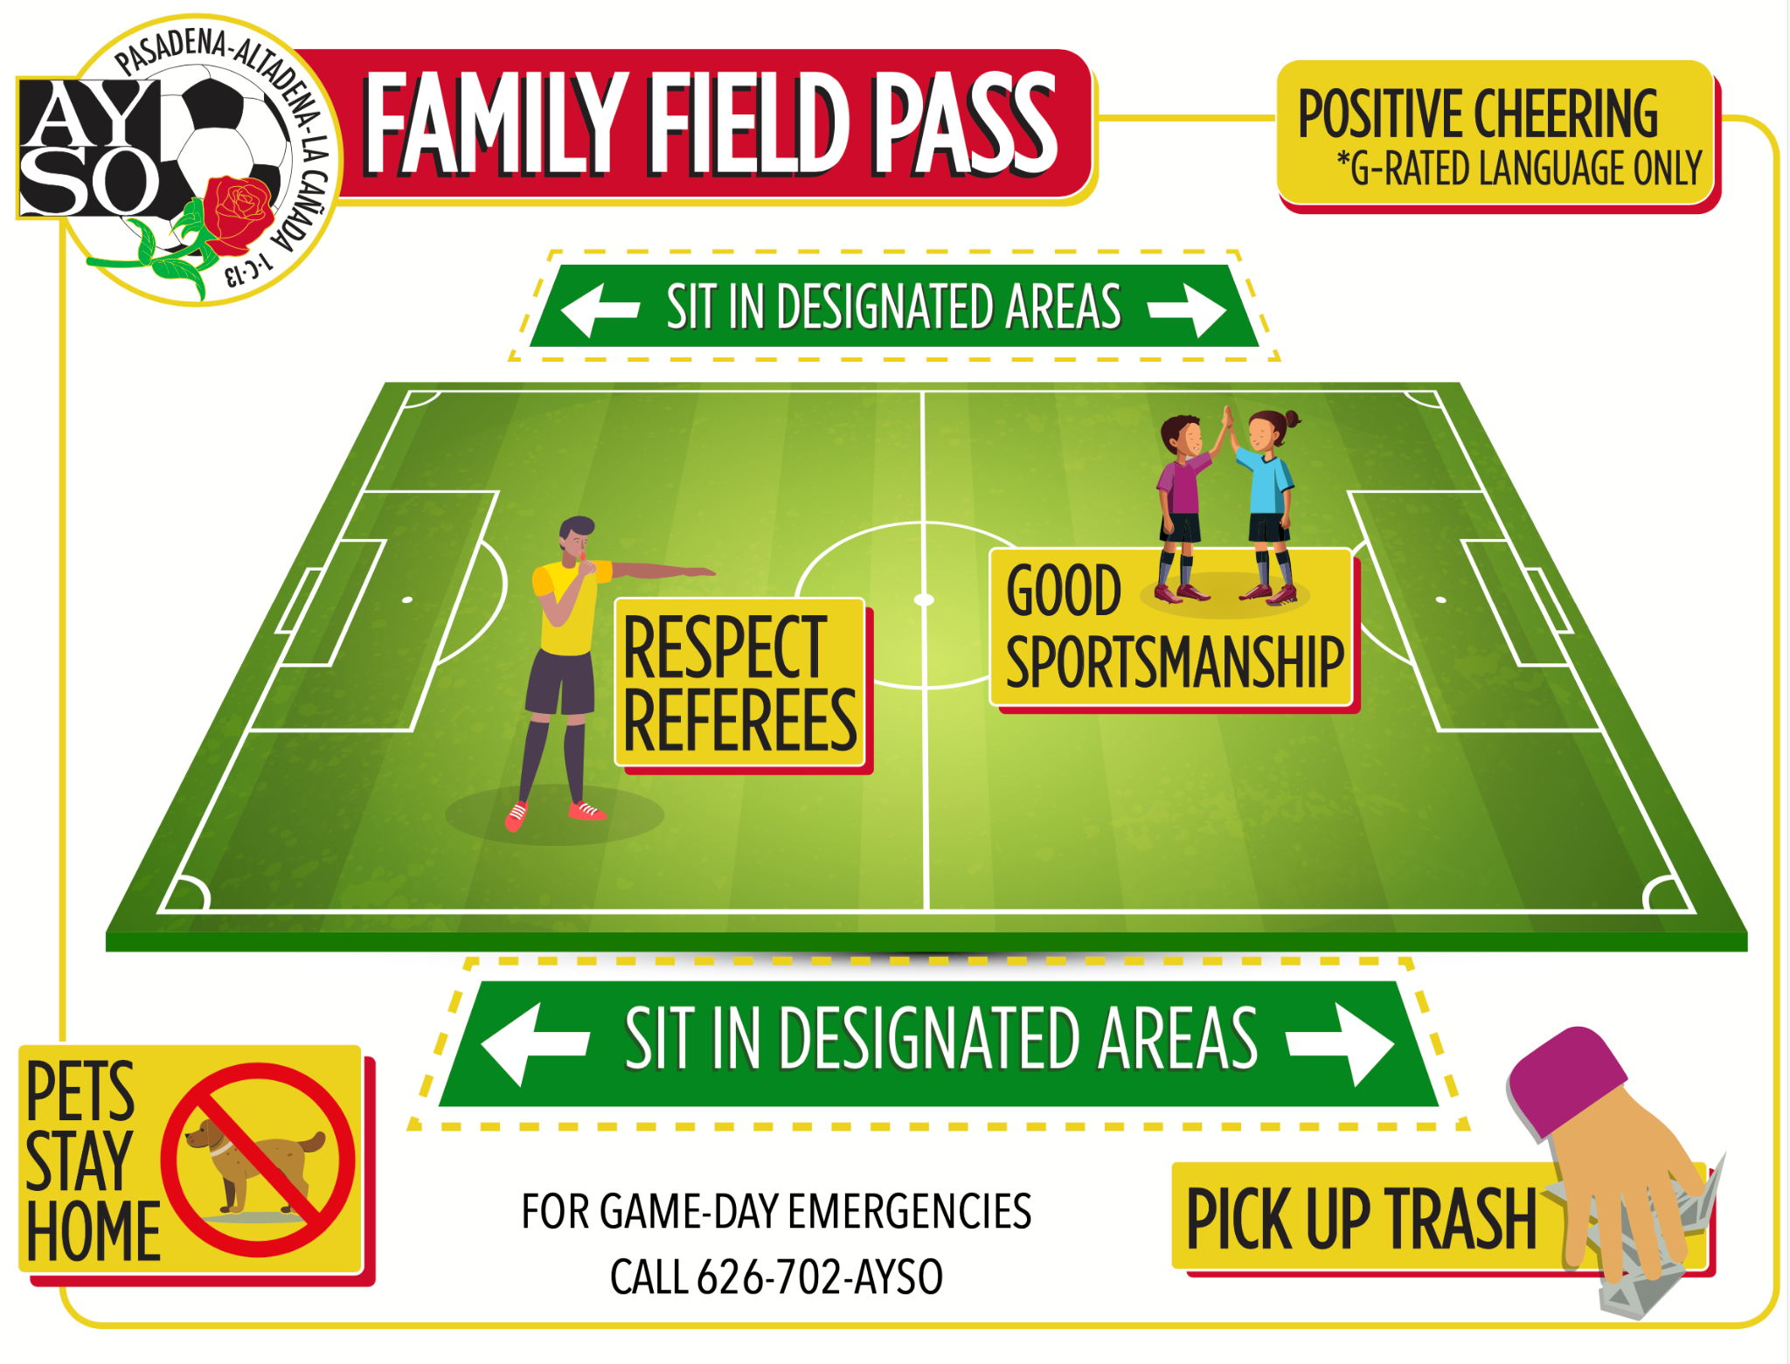
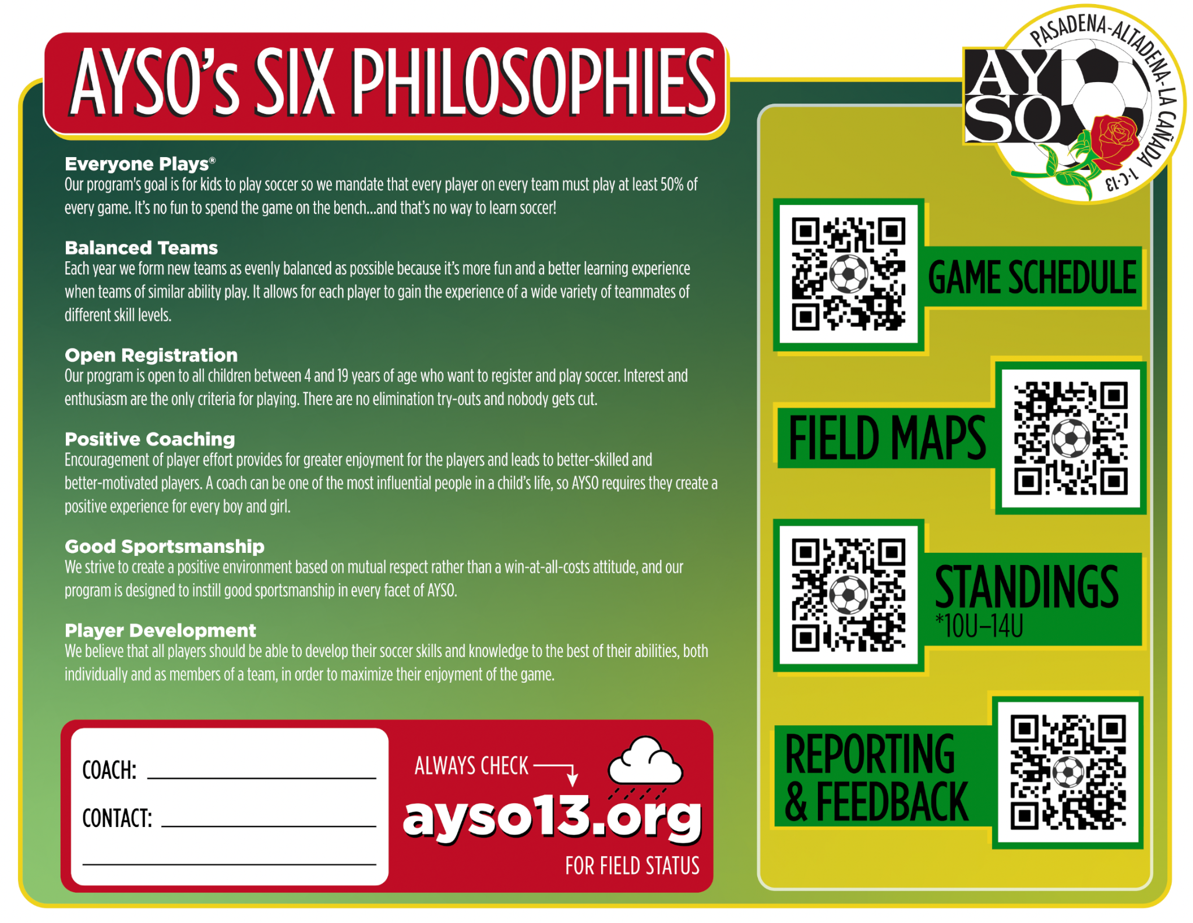
Family Field Pass
Region 13 continues to try to improve messaging with families
Created the Family Field Pass with what families need to know
These are included in your coach bags - Please share with your team

Slide 10


Uniforms & Equipment
Uniforms
May be picked up by Head Coach or delegate. Delegate must know division (i.e.; G6U), coaches last names and shirt sizes!
Uniforms have a normal distribution of sizes and include socks, shorts, and jerseys
Pick-ups:
  Thursday, 8/28 - 5-6pm
  Friday, 8/29 - 5-6pm
  Saturday, 8/30 - 9-11am
  Friday, 9/5 - 5-6pm
Question? Contact celina@ayso13.org
Equipment
We supply Head Coach with 3 balls
(size 3), a Coach bag, cones, ball pump, first aid kit, pinnies
Head and Assistant Coaches each get a coach shirt - wear at every game.
Some coaches choose to buy pop up goals, rolling cart to carry your stuff, extra set of cheap shin guards (keep in your bag for the forgetful player)

Slide 11
Use Your Support Network!
Coaches:
Coaches are a team. It’s easier if HC and AC work together. Play to each of your strengths
Referees:
Cover your referee assignments so you don’t have to
Are also learning
Be nice to them
Team Managers:
Handle pictures, trophies, snack schedule, etc.
Administrative support: team communication, Spond updates, uploading forms, etc.
Can recruit/schedule parents to help set up/take down goals
Other Coaches:
Can provide coverage - If you or your AC must miss a game, any certified coach can cover for you. Contact your DCA for help!

Slide 12
Use Your Support Network!
Website: search the website first!!! - https://ayso13.org/
Division Coach Admin. (DCA): First stop for coach issues or questions
B6U: Lauren Stevenson &
Mark Cholko - coachb6u@ayso13.org
G6U Jonathan Lui - coachg6u@ayso13.org
B7U Susan Streets - coachb7u@ayso13.org
G7U Brandi Lane - coachg7u@ayso13.org
B8U Tona Rodriguez - coachb8u@ayso13.org
G8U Suset Chaney - coachg8u@ayso13.org
Regional Coach Admin: when the DCAs can’t help or are unavailable
RCA Brandi Lane - brandi@ayso13.org
Division Referee Admin. (DRA): Equivalent to the DCAs but on the Referee side
6U-8U Harry Plotkin - referee@ayso13.org
Regional Referee Admin: when the DRAs can’t help or are unavailable
RRA Harry Plotkin - referee@ayso13.org
Regional Commissioner (RC):
Patrick Shopbell- patrick@ayso13.org

Slide 13
Before the Game
Arrive Early - (30+ min). Need time to find parking (e.g., Victory park in the AM), set up goals, warm up, etc. If you don’t get there early, parents won’t either. Some parents will always be late.
Set-up for First Game of the Day: Each team sets up one field (2 goals
and flags at the corners. Task your parents with this and have them start
immediately. Game must start on time!
Introductions - Introduce yourself to the other coaches and referees.
Balance Teams - if one team is missing a number of players, the other team should lend players to them so that teams are of roughly balanced in number of players. If both teams are missing a number of players, you may also play only one one field (so 6v6 on one field instead of 3v3 on two). Use pinnies as needed.
Referee Check-in - Inform the Referee if any player needs extra help; help Ref check in players.
Home & Away - Home team sits on North or West side of field and supplies 2 balls. Away team sits on South or East side of field and supplies 1 ball.
Uniforms - Coaches wear Coach shirts. Players wear uniforms. Home team wears pinnies if colors are similar.
Goal set up reminders will be sent to applicable Head Coaches the night before the game.

Slide 14
Referee Assignments
Referees - Tell your coach if you cannot make an assignment
If your Referees cannot cover an assignment:
  First email the opposing coach to see if their Referees can help cover
  Then email your DRA for help
  Do this as far ahead as possible - Friday night will not work!
There could be 4 Referees at each game (2 from each team) but just 2 total can suffice for coverage
  1-2 Referees on each field
Youth (PRO) Referees - please be aware that there may be youth Referees at your games known as PRO Referees. Be kind - there is zero tolerance for mistreatment of them.

Slide 15
During the Game
Region 13 may alter/cancel games in very hot weather. We will follow CIF policies for determining that
Referee Treatment - Be nice to the Referees. Be professional.
Coach Positioning
  6U coaches may coach on the pitch throughout the season.
  7U coaches may coach on the pitch for the Sept. Starting Oct., coach from the touchline. An announcement but remind each other if needed.
  8U coaches must coach from the technical area on the touchline all season. Please do not coach from the field and remind each other if needed.
Score - Adults do not keep score! Remind players not to keep score!
Playing Time - All players play the entire time (unless a player chooses not to).
Safe, fair, and Fun!

Slide 16
After the Game
Referee Treatment - Have the players thank the referees after the game or give them a cheer. If your Referees were awesome, submit a positive Referee Feedback Form!
Cheer / Handshake - Do a cheer for the opposing team (2-4-6-8 who do we appreciate…). Line up along the half line at the center circle and do hand taps or fist bumps. Players should not carry water bottles or anything in their hands. You are also welcome to do parent tunnels - many have both teams go through the tunnels!
Keep our Fields Clean - Have parents/families clean up their trash (and any other trash they find!) so that the fields are clean for the next team(s).
Last Game of the Day - Each team takes down one goal, flags, etc. Returns it to storage.

Slide 17
What to do When There is a Problem
Problem with a Referee or Coach?
If you have a problem with a Referee or Coach report it to us instead of discussing it with them directly. There are two options for reporting:
Problem with a Referee
  Contact the Division Referee Administrator (DRA) - DRA will talk to the Referee
  Submit a Referee Feedback Form
Problem with another Coach
  Contact the Division Coach Administrator (DCA) - DCA will talk to the Coach
  Submit a Coach Feedback Form
Other Problems / Incidents?
If you have a problem with a parent, spectator, or other area, you may report as needed to one of the following:
General - info@ayso13.org
Write the commissioner directly - rc@ayso13.org
Child & Volunteer Protection Advocate - cvpa@ayso13.org
Auditor - auditor@ayso13.org
Please remember - Respect The Referee Policy

Slide 18
Managing Parents / Spectators
Coaches are responsible for their touchline - Set expectations early on; it will be harder to deal with later.
Coaches coach, parents cheer
Try to keep it P.I.E. even when managing parents
Spectators should sit 10’ away from touchline, between the two penalty areas
How to identify problem parents/spectators:
  Tends to drift away from midfield
  Coaches their kid during the game
  Yells at the ref
  Takes things too personally
If you’ve tried to correct a parent but he/she continues to be a problem, please let your DCA know

Slide 19

Investigation into Misconduct
Board members will investigate reports of coach misconduct (from a Game Gard, volunteer, Coach Feedback Form, parent, etc.).
A member of the board or the Dispute Resolution Panel
will contact you for a phone conversation and/or
written account to hear your side of the story.
Other witnesses will similarly be interviewed.
All information will be submitted to Regional Commissioner who will decide what actions, if any, will be taken.
Potential actions can include warnings, game suspension, etc. and may impact a volunteer’s opportunity to coach in the future

Slide 20
Player Ratings - 8U Only
No preliminary ratings needed, just final ratings at end of season
Your initial ratings will probably be too high - try to follow the guidance:
  Rating/Assessment Guidelines
Be sure to add jersey numbers and player comments. Example:
  OK: Kicking is a strength, positioning is weakness
  Better: Kris is a solid defender and has a huge kick that is useful for clearing the ball. Tends to get pulled out of position on defense but is fast enough to usually recover. Would be a great striker if Kris learned where to be on offense.
REMINDER! Accurate ratings are important for our ability to form balanced teams

Slide 21
6U-8U Volunteers
Volunteer Role | Ideal | Minimum
Head Coach | 1 | 1
Assistant Coach | 1 | 1
Referee | 2 (or more) | 2
Team Manager | 1 | 0
Volunteers must be fully certified - see website for requirements: https://ayso13.org/volunteer/

Slide 22
Field Issues
We are guests on all the fields we use. Please help us retain access to fields. Please:
  Pick up any trash
  Do not damage the field (e.g., drag goals across the grass)
  Do not damage any property (e.g., do not force open a lock)
  Do not allow anyone to climb over a locked fence, even if we have a permit - it’s trespassing
For immediate logistical issues – e.g. locked field, no lights – text Rolf at 818-636-5395 for help and start with AYSO.
Report any non-immediate issue to fields@ayso13.org (e.g., broken sprinkler, broken light. Not gopher holes, we are working with owners to address that)
For longer-term practice scheduling issues – e.g. field not working out, another coach claims same spot – email practice@ayso13.org

Slide 23
Miscellaneous Items
NO unsanctioned practices!!! We risk losing field permits.
Take care of the fields, ditto for losing permits.
You must make sure each player on your team gets picked up. Coaches are the last to leave, always (and should be the first to arrive)!
Leave pets at home - NO PETS are allowed on AYSO fields.
Remind your players not to get their ears pierced during the season. They will not be allowed to wear earrings during a game, no exceptions.

Slide 24
Questions?

