Slide 1
14U Division Coach Meeting
August 27, 2025

Slide 2
THANK YOU!
Thank you for volunteering to coach! Because of you, our kids get to play soccer.

Slide 3
Agenda
Coach expectations, requirements & to do list
Parent & medical release forms
Uniforms and equipment
Supporting Coaches
What happens before, during and after games & Game Cards
When Coach/Referee problems arise & managing parents / spectators
Playoffs - format & requirements (incl. Referee & Sportsmanship Points)
Upcoming events
Miscellaneous items
Questions?

Slide 4
Your Admins
Divisional Admins |  | League Admins
B14U DCA | Azeem Khaja | Regional Commissioner | Patrick Shopbell
G14U DCA | Frank Garibaldo | Regional Coach Administrator | Brandi Lane
14U DRA | Jeffrey Lawler | Deputy RCA | Susan Streets
 |  | Regional Referee Admin | Harry Plotkin

Slide 5
What We Expect From Coaches
Conduct
PIE: Positive, Instructional, Encouraging
Coaches set the tone for players and parents
Be professional - we expect behavior that would
be acceptable at work
Referee Treatment
(Respect The Referee Policy and Referee Abuse Policy)
Be nice to the refs.
Most coaches have to recruit referees. Why is it so difficult? Top reason: referee criticism
Zero tolerance for referee criticism
Less than zero tolerance for yelling at or criticizing youth refs.
Manage your sideline. Coaches coach. Parents/spectators cheer. No one yells at refs
Remember, we are a community. Coaches are a team with referees, parents, other coaches. This year you might be on opposing teams, but next year you may be on the same team!
AYSO Vision & Philosophies
To provide world class youth soccer programs that enrich children’s lives
Development over winning
Positive Coaching

Slide 6
Coach Requirements
Volunteer Application & Background Check
Required annually, specifically for AYSO
AYSO uses Sterling Volunteers for background checks - do NOW (results can take weeks)
Training
(Helpful links: AYSO R13 Coach, Volunteer FAQ, AYSO 13 Calendar)
Intermediate Coach Course (online + field session)
Livescan Fingerprinting
Safe Haven (online)
Safesport (online)
Sudden Cardiac Arrest (online)
CDC Concussion Course (online)
Why is this training required? → Volunteer Protection Act
Certification is Important!
If you do not complete your coaching requirements, you are not allowed to coach.
If your team does not have a certified coach present they cannot practice or play/participate in a game.

Slide 7

Coach To Do List
Practices Schedule
Should have received late last night!
Check with your players for conflicts and let your DCA know
Confirm Your Players & Volunteers
If you have not received your roster, reach out to your DCA ASAP!
If you have not, reach out to all your players ASAP to introduce
yourself and confirm they are going to participate
Let your DCA know if any of your players are dropping / not playing
Confirm preassigned volunteers & recruit additional volunteers as needed - inform your DCA of new additions or change
Communications
Set your expectations for the parents - managing parents is more difficult than players
We recommend using a ‘team app’ e.g., Spond for communications. Check time zone!!
Your Team Manager could help with this!

Slide 8
Parent & Medical Release Forms
Parent Forms
Have parents sign CDC Concussion, Sudden Cardiac Arrest (SCA), and Parent Pledge
Forms available at https://ayso13.org/forms/
Upload pictures of signed CDC Concussion and SCA to https://ayso13.org/forms
Player Medical Release Forms
One coach (HC, AC, or sub coach) must have a physical copy of the medical release forms for each player at every game and practice (print them out, put them in a binder, keep it in your coach bag)
Recommended way of printing Medical Release Forms: https://ayso13.org/coach-training/medical-forms/
Forms are also on your Google Team Sheet. Sign into InLeague
before clicking on the form link in your Google Team Sheet, or
else you will receive an error.
Ask your Team Manager to help
with these tasks!

Slide 9
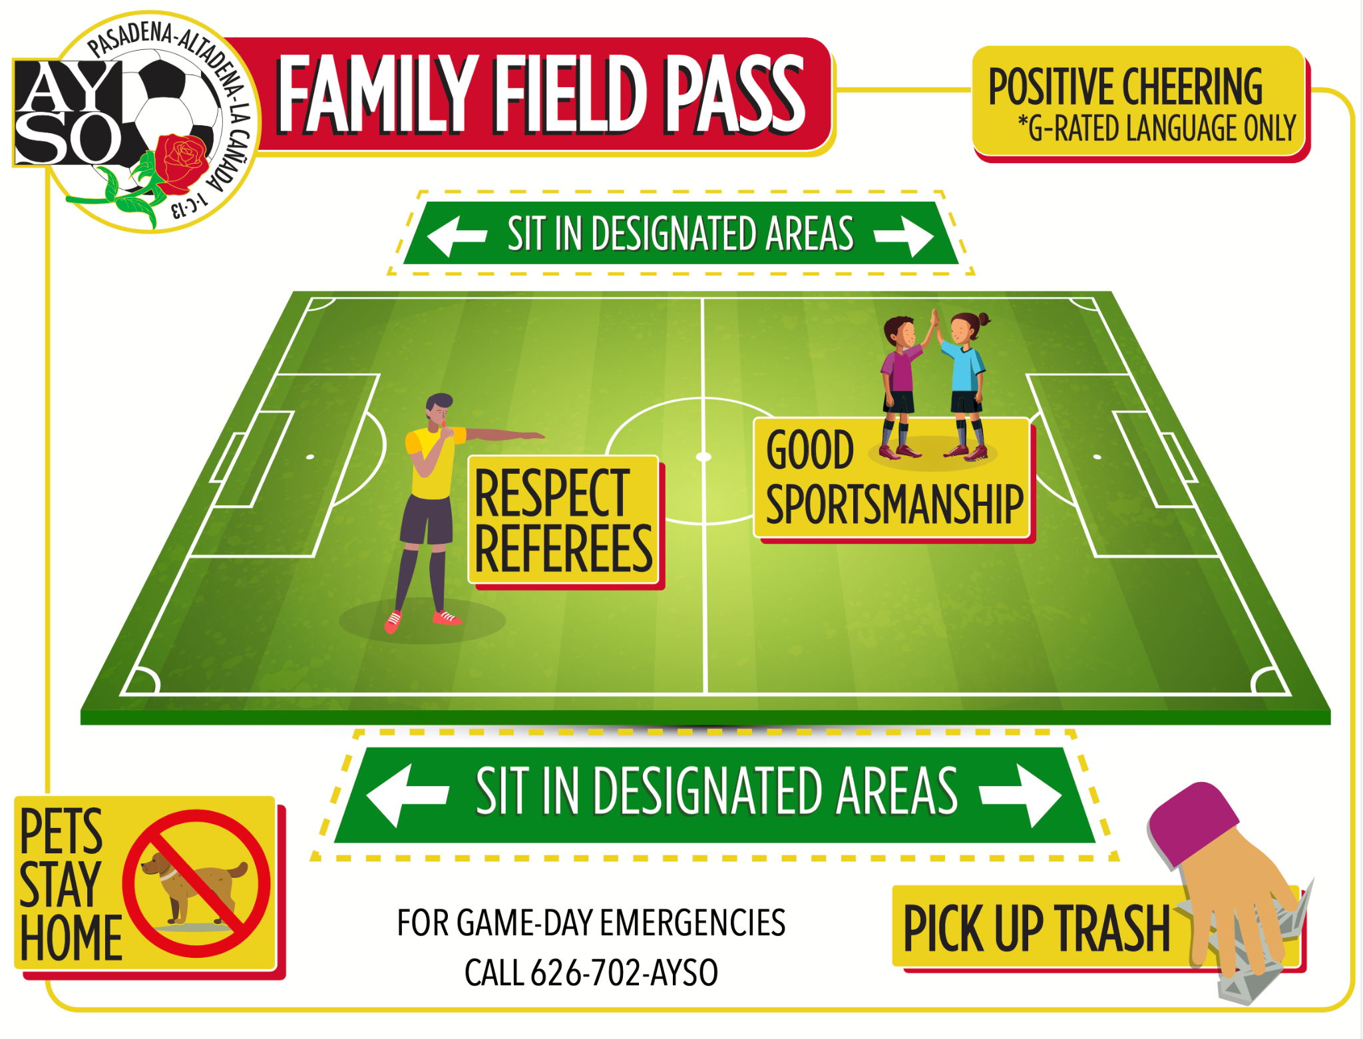
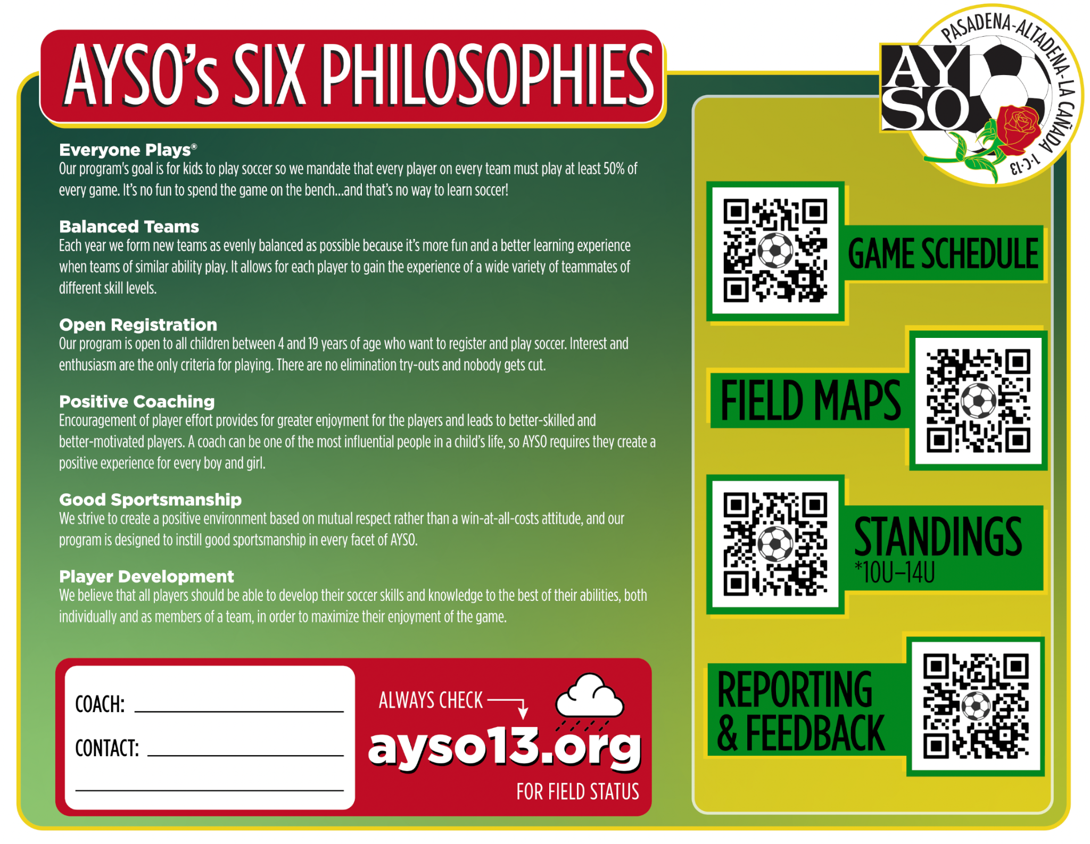
Family Field Pass
Region 13 continues to try to improve messaging with families
Created the Family Field Pass with what families need to know
These are included in your coach bags - Please share with your team

Slide 10


Uniforms & Equipment
Uniforms
May be picked up by Head Coach or delegate. Delegate must know division (i.e.; B14U), coaches last names and shirt sizes!
Uniforms have a normal distribution of sizes and include socks, shorts, and jerseys
Pick-ups:
  Thursday, 8/28 - 5-6pm
  Friday, 8/29 - 5-6pm
  Saturday, 8/30 - 9-11am
  Friday, 9/5 - 5-6pm
Question? Contact celina@ayso13.org
Equipment
We supply Head Coach with 3 balls
(size 5), a Coach bag, cones, ball pump, first aid kit, pinnies,and a goalie shirt & gloves
Head and Assistant Coaches each get a coach shirt - wear at every game.
Blank game cards on cardstock
Some coaches choose to buy pop up goals, rolling cart to carry your stuff, extra set of cheap shin guards (keep in your bag for the forgetful player)

Slide 11
Use Your Support Network!
Your Team
Coaches:
Coaches are a team. It’s easier if HC and AC work together. Play to each of your strengths
Referees:
Cover your referee assignments so you don’t have to
Are also learning
Be nice to them
Team Managers:
Handle pictures, trophies, snack schedule, etc.
Administrative support: team communication, Spond updates, uploading forms, etc.
Can recruit/schedule parents to help set up/take down goals
Other Coaches:
Can provide coverage - If you and your AC must miss a game, any certified coach can cover for you
The Region
Website: search the website first!!! -https://ayso13.org/
Division Coach Admin. (DCA): First stop for coach issues or questions
B14U Azeem Khaja - coachb14u@ayso13.org
G14U Frank Garibaldo - coachg14u@ayso13.org
Division Referee Admin. (DRA): Equivalent to the DCAs but on the Referee side
14U Jeff Lawler - ref14u@ayso13.org
Regional Coach & Referee Admins. : For when the DCAs / DRAs can’t help or are unavailable
RCA Brandi Lane - brandi@ayso13.org
RRA Harry Plotkin - referee@ayso13.org
Regional Commissioner (RC):
Patrick Shopbell - rc@ayso13.org

Slide 12
14U Volunteers
Volunteer Role | Ideal | Minimum
Head Coach | 1 | 1
Assistant Coach | 1 | 0
Referee | 2 | 1
Team Manager | 1 | 0
Volunteers must be fully certified - see website for requirements: https://ayso13.org/volunteer/

Slide 13
Before the Game
Arrive Early - (30+ min). Need time to find parking (e.g., Victory park in the AM), set up goals, warm up, etc. If you don’t get there early, parents won’t either. Some parents will always be late.
Set-up for First Game of the Day: Each team sets up one goal
(make sure the goals are anchored!) and two flags at the corners.
Task your parents with this and have them start immediately.
Game must start on time!
Introductions - Introduce yourself to the other coaches and referees.
Referee Check-in - Give your game card to the referee, inform them of your players who will miss the game, or if you have a player that needs extra help, help manage team as Ref checks them in.
Home & Away - Home team sits on North or West side of field and supplies 2 balls. Away team sits on South or East side of field and supplies 1 ball.
Uniforms - Coaches wear Coach shirts. Players wear uniforms. Home team wears pinnies if colors are similar.
Goal set up reminders will be sent to applicable Head Coaches the night before the game.

Slide 14
Referee Assignments
Ask your Referees to use inLeague to confirm their assignment
If your Referees cannot cover an assignment:
  First email the opposing coach to see if their Referees can help cover
  Then email your DRA for help
  Do this as far ahead as possible - Friday night will not work!
  If your team misses referee assignments, it can/will affect your ability to qualify for playoffs
Team Referee Assignments
  AR ONLY the game before
  Region 13 assigns Center Referees for games
  If you find out your Referee wants to be a Center Referee and/or level-up their badge, please have them reach out to:
    14U DRA - Jeff Lawler - ref14u@ayso13.org
    Regional Referee Administrator (RRA) - Harry Plotkin - referee@ayso13.org
Click to see more details on Referee Assignments

Slide 15
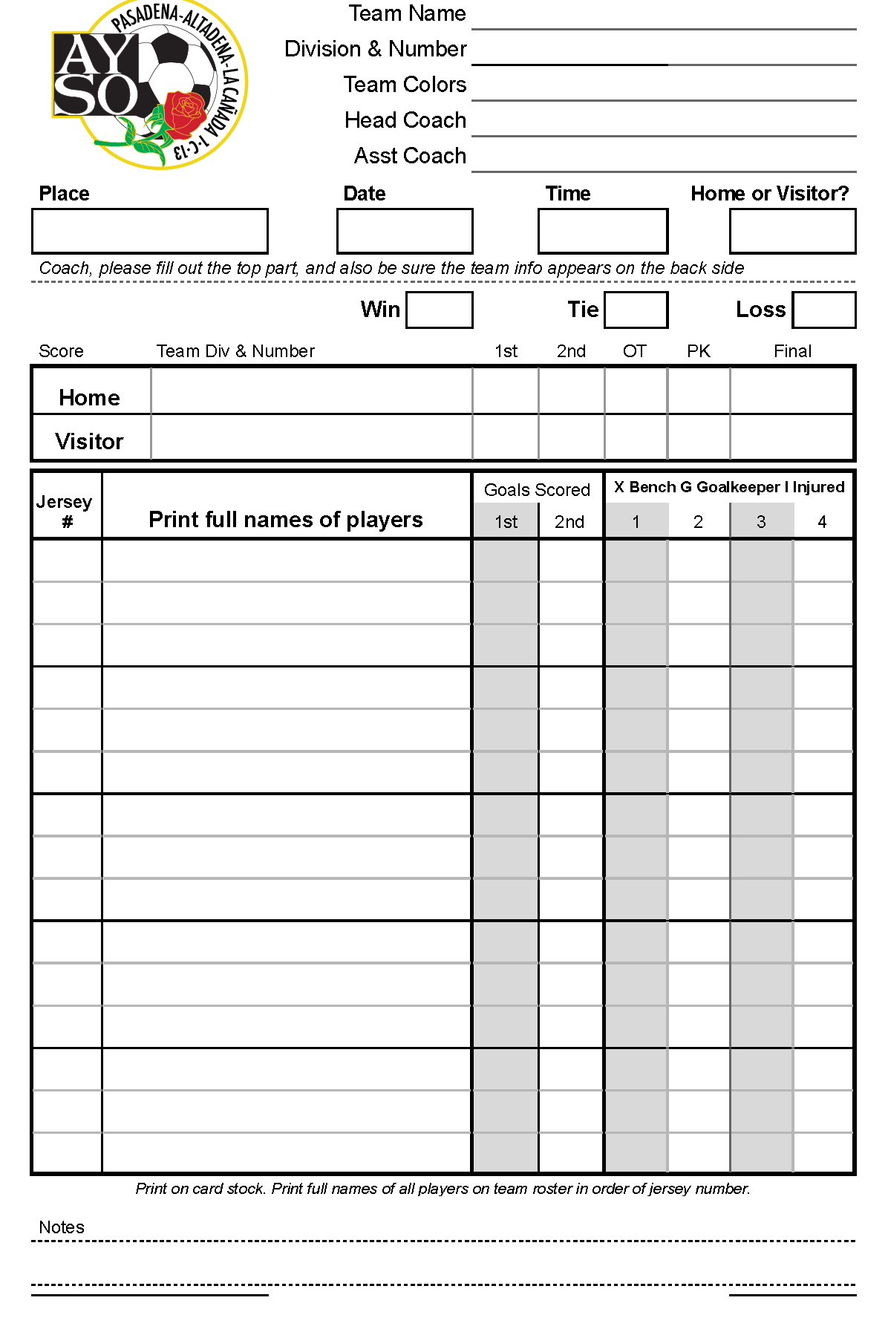
Game Cards
Why are Game Cards important?
The game card is a record of the game
We monitor and follow up on game comments
Filling out a Game Card
If you print at home from your Google Team Sheet - must be printed on cardstock.
Blank game cards available at R13 clubhouse and given out with your equipment.
Player listing
  In numerical order smallest to largest
  List ALL players, present or not
  First AND Last Names
Fill in all the blanks
Don’t cross out missing players or substitutes
(that’s the Referee’s job)

Slide 16
During the Game
Region 13 may alter/cancel games in very hot weather. We will follow CIF policies for determining that
Referee Treatment - Be nice to the Referees. Be professional.
Coach Positioning - Coaches must remain in Technical Area. Stay
back from the touchline so the Assistant Referee (AR) can see properly.
Playing Time
  All players must play at least 3/4 of a game, when numerically possible. Games can be forfeit if this is violated. This is the Coach’s responsibility (not the Referee’s). Make sure the referee notes on the game card reasons why a player may not play 3/4 (refuses to play, injury, arrived late, etc.).
  No restrictions on goalie time in 14U
Blowouts - Have a plan for blowouts. Be proactive (you can tell early on). Start moving players, make the game more challenging (use left foot), play your scorer as goalie, only shots from outside penalty area, etc. Be discrete. Keep the goal differential 6 or under.
Safe, fair, and fun!

Slide 17
After the Game
Referee Treatment - Have the players thank the referees after the game or give them a cheer. If your Referees were awesome, submit a positive Referee Feedback Form!
Cheer / Handshake - Do a cheer for the opposing team (2-4-6-8 who do we appreciate…). Line up along the half line at the center circle and do hand taps or fist bumps. Goalies should not wear goalie gloves, players should not carry water bottles or anything in their hands.
Keep our Fields Clean - Have parents/families clean up their trash (and any other trash they find!) so that the fields are clean for the next team(s).
Last Game of the Day - Each team takes down one goal, flags, etc. Returns it to storage.

Slide 18
What to do When There is a Problem
Problem with a Referee or Coach?
If you have a problem with a Referee or Coach report it to us instead of discussing it with them directly. There are two options for reporting:
Problem with a Referee
  Contact the 14U Division Referee Administrator (DRA) - DRA or RRA will talk to the Referee
  Submit a Referee Feedback Form
Problem with another Coach
  Contact the 14U Division Coach Administrator (DCA) - DCA or RCA will talk to the Coach
  Submit a Coach Feedback Form
Other Problems / Incidents?
If you have a problem with a parent, spectator, or other area, you may report as needed to one of the following:
General - info@ayso13.org
Write the commissioner directly - rc@ayso13.org
Child & Volunteer Protection Advocate - cvpa@ayso13.org
Auditor - auditor@ayso13.org
Please remember - Respect The Referee Policy

Slide 19
Youth Referees
Youth referees have gone through the same training as every other referee
Many are refereeing because not enough adults are volunteering
Your responsibility is to ALL kids on the field, INCLUDING any youth referees. All the adults on the field - coaches, referees, spectators - MUST make sure that our youth referees are protected
Absolutely no negative comments towards youth referees. The threshold is lowered for sanctions, and the severity of sanctions increased for misconduct against youth referees

Slide 20

Examples of Unacceptable Behavior
Directed to the Referee:
“C’mon Ref!”
“That’s a terrible call.”
“Get it together ref, someone is going to get hurt.”
“Call it both ways, ref!”
“What was that??”
“That’s not a goal! He can’t score like that!”
Language that can’t be used in a G rated movie.
Directed to Assistant Coach, Parents, Players:
“It’s ok kids, this ref doesn’t know what he’s doing”
“Don’t worry we’re losing kids, we’re playing against 12 today.”
“We all know that that was a goal, the Ref just sucks”
“I was just talking to my Assistant Coach” does not justify inappropriate comments.
Nonverbal Actions:
Stepping onto the field
Number one salute
Leaving the technical area
Following the referee around

Slide 21
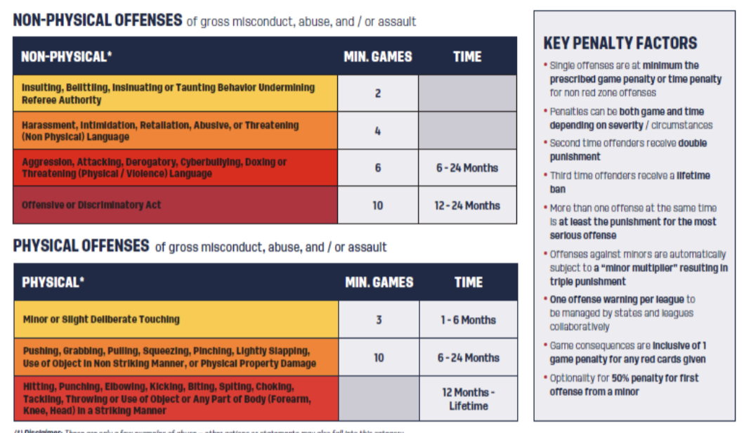
NEW Referee Abuse Policy

Slide 22
Managing Parents / Spectators
Coaches are responsible for their touchline - Set expectations early on; it will be harder to deal with later.
Coaches coach, parents cheer
Try to keep it P.I.E. even when managing parents
Spectators should sit 10’ away from touchline, between the two penalty areas
How to identify problem parents/spectators:
  Tends to drift away from midfield
  Coaches their kid during the game
  Yells at the ref
  Takes things too personally
If you’ve tried to correct a parent but he/she continues to be a problem, please let your DCA know

Slide 23

Investigation into Misconduct
Coach staff will investigate reports of coach misconduct (from a Game Gard, volunteer, Coach Feedback Form, parent, etc.).
A member of the board or the Dispute Resolution Panel
will contact you for a phone conversation and/or
written account to hear your side of the story.
Other witnesses will similarly be interviewed.
All information will be submitted to Regional Commissioner who will decide what actions, if any, will be taken.
Potential actions can include warnings, game suspension, etc. and may impact a volunteer’s opportunity to coach in the future

Slide 24

Playoffs - Format & Requirements
Playoff Rankings - Tiebreakers
Coaches must submit player ratings
Sportsmanship Points
Referee Points
Playoff Format
Pool format - Details and bracket structures released closer to playoff dates
Single elimination - May need to play two games in one day
Timing - Held first two weekends after Thanksgiving
Winners - Winners of both regular season and of playoffs go on to Area play the following weekend

Slide 25
Player Ratings
Preliminary ratings (mid-season) due ~week 5
  Needed to form Thanksgiving Tournament teams and for All Stars scouting
Your initial ratings will probably be too high - try to follow the guidance:
  Rating/Assessment Guidelines
Be sure to add jersey numbers and player comments. Example:
  OK: Kicking is a strength, positioning is weakness
  Better: Kris is a solid defender and has a huge kick that is useful for clearing the ball. Tends to get pulled out of position on defense but is fast enough to usually recover. Would be a great striker if Kris learned where to be on offense.
REMINDER! Accurate ratings are important for our ability to form balanced teams

Slide 26
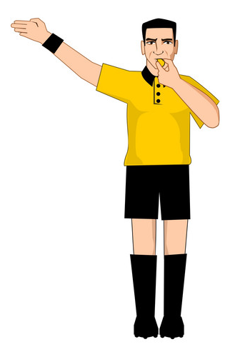
Referee Points
Teams earn Referee Points:
1 point for an Assistant Referee (AR) assignment
What happens if a Referee cannot make an assignment?
First, contact the opposing Coach to see if they have a Referee who can fill in.
If unsuccessful, contact your DRA. Do this early in the week!
The credit listed on the back of the game card determines the credit
What happens if a team misses their assignment?
A team can make up points by filling in for another team who needs a Referee replacement.
Regional Commissioner may evaluate special circumstances resulting in a missed assignment and adjust points.
Task | Points per game | Total Points possible (Season)
Assistant Referee | 1 point | 10 points

Slide 27

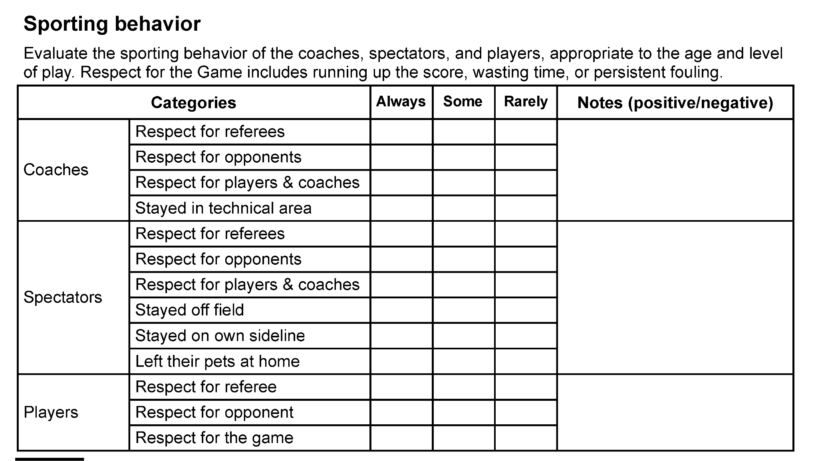
Sportsmanship Points
Center Referee awards sportsmanship points through Coaches,
spectators, and players showing good sportsmanship.
Each team starts with the max number of points
Center Referee may deduct points when warranted.
Examples of actions at a game that will result in lost points:
Receives one (1) red card/ejection or two (2) yellow cards/cautions.
Does not play players the required 3/4 game without valid reason.
Fails to do scheduled set up or take down of fields.
Perpetrates any violent or unruly behavior.
The following criteria shall be applied when assessing the team’s overall rating
Player Conduct: incl. but not limited to uniform appearance, courtesy toward Refs, overall attitude and field behavior.
Coach Conduct - incl. but not limited to courtesy toward Refs, overall attitude/sideline behavior, field takedown/ setup (if scheduled), positive & encouraging coaching, control of spectators, organization (subs at quarters etc.)
Spectator Conduct - incl. but not limited to courtesy toward Refs, positive support of players, and observance of sideline restrictions
Points per game | Total Points possible (Season)
5 points | 50
Points will be posted
throughout the season

Slide 28
Field Issues
We are guests on all the fields we use. Please help us retain access to fields. Please:
  Pick up any trash
  Do not damage the field (e.g., drag goals across the grass)
  Do not damage any property (e.g., do not force open a lock)
  Do not allow players to climb over a locked fence, even if we technically have a permit. That is trespassing
For immediate logistical issues – e.g. locked field, no lights – text Rolf at 818-636-5395 for help.
Report any non-immediate issue to fields@ayso13.org (e.g., broken sprinkler, broken light. Not gopher holes, we are working with owners to address that)
For longer-term practice scheduling issues – e.g. field not working out, another coach claims same spot – e-mail practice@ayso13.org

Slide 29
Miscellaneous Items
NO unsanctioned practices!!! We risk losing field permits.
Take care of the fields, ditto for losing permits.
You must make sure each player on your team gets picked up. Coaches are the last to leave, always (and should be the first to arrive)!
Leave pets at home - NO PETS are allowed on AYSO fields.
Remind your players not to get their ears pierced during the season. They will not be allowed to wear earrings during a game, no exceptions.

Slide 30
Questions?

